Slide 1


Hotel Database Management System
Harish G RA2111026010284

Slide 2


CONTENTS
Abstract
Project Modules
Business Perspective
ER Diagram
Relational Table
DDL, DML, DCL, TCL

Slide 3
ABSTRACT
HDMS utilizes MySQL to efficiently organize, store, and manage hotel-related data, tailored for complex hotel operations.
The system aims to enhance all aspects of hotel operations, including centralized data management, streamlined reservation processes, optimized room allocation, personalized guest experiences, robust reporting, and user-friendly accessibility.
HDMS serves as a centralized repository for guest information, room inventory, reservations, billing, staff details, and inventory management, providing administrators with essential tools for excellence.
From simplifying reservations to automating billing, HDMS ensures smooth operations and optimal resource utilization, enhancing efficiency throughout the hotel.

Slide 4
ABSTRACT
HDMS enhances guest satisfaction by capturing and analyzing guest preferences and behaviors, enabling hotels to deliver personalized services such as room preferences and special amenities, resulting in memorable and tailored experiences for every guest.
The system facilitates effective communication and relationship-building with guests, allowing hotels to personalize interactions, anticipate needs, and foster long-term guest loyalty.
HDMS aims to streamline hotel operations, optimize workflows, and reduce operational costs through automation and process improvements.
By seamlessly integrating technology with hospitality, HDMS redefines hotel management, elevating guest experiences and maximizing profitability in the hospitality industry.

Slide 5
Identification of Project Modules & Functionality
Guest Management
Guest registration and profile creation
Check-in and check-out procedures
Guest preferences and special requirements tracking
Handling guest inquiries and complaints
Employee Management
Staff information management
Personal Information
Task assignment and tracking
Designation & Department
Integration with payroll and attendance systems
Room Management
Room Type
Real-time room status updates
Room allocation and assignment
Room pricing and rate management
Integration with housekeeping and maintenance systems

Slide 6
Identification of Project Modules & Functionality
Booking Management
Reservation creation, modification, and cancellation
Availability management
Integration with online booking channels
Booking confirmation and communication
Reporting and analytics on booking trends
Services Management
Management of hotel services
Service request handling
Inventory management for service-related items
Service quality monitoring and improvement
Integration with billing and payment systems

Slide 7
Challenges and Issues in Business Perspective
Data Security and Privacy
Data Integrity
Scalability
Integration with other systems
Performance Optimization
Concurrency Control
Cost Management
System downtime

Slide 8
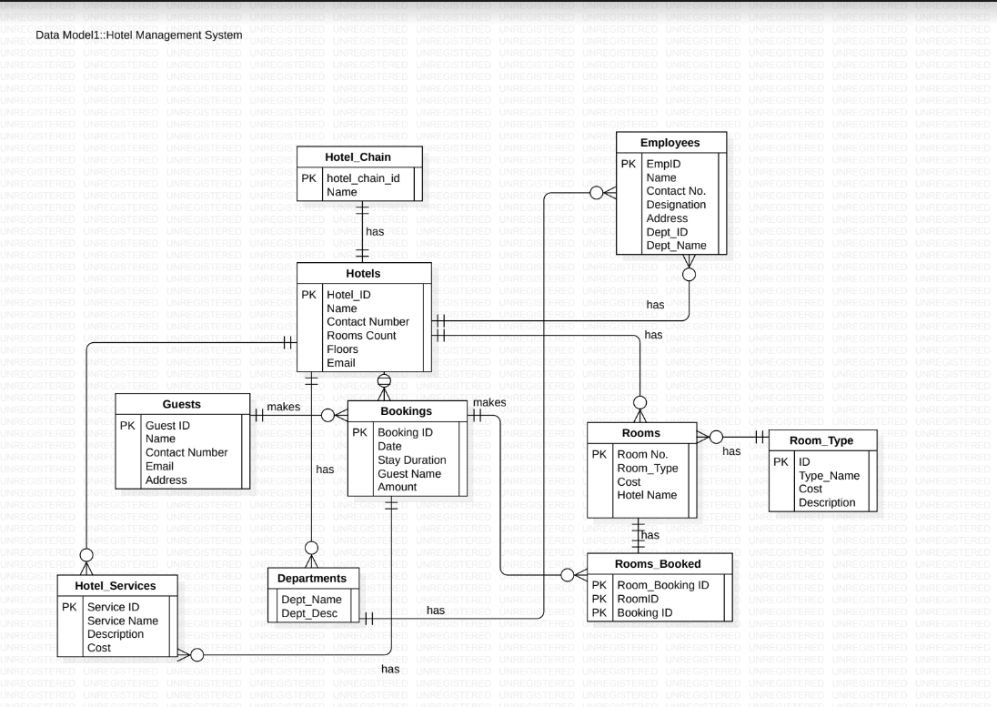
ER Diagram

Slide 9
ER Diagram to Relational Table

Slide 10
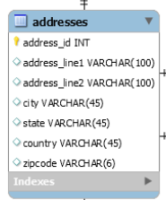
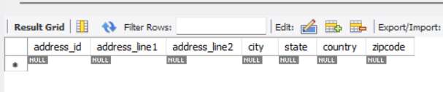
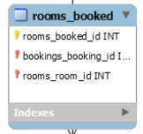
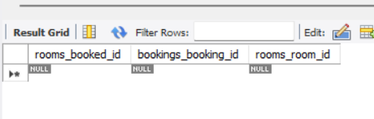
Entity with Normal Primary Key and other attributes:
Entity with only Primary Key and Foreign Keys from other tables:

Slide 11
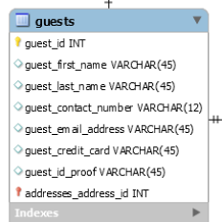
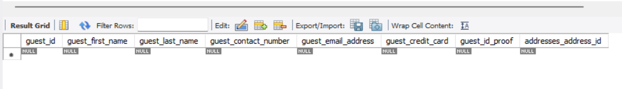
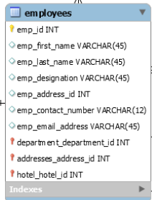
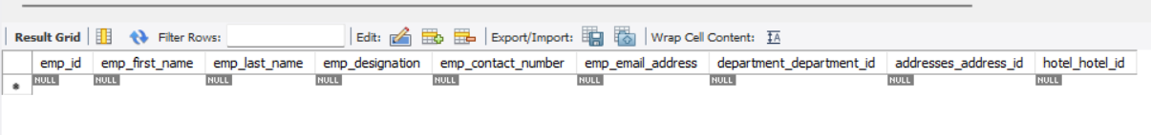
Entity with 1 Primary Key, 1 Foreign Key and other attributes:
Entity with a Primary Key and many Foreign Keys from other tables:

Slide 12
Data Definition Language (DDL)

Slide 13
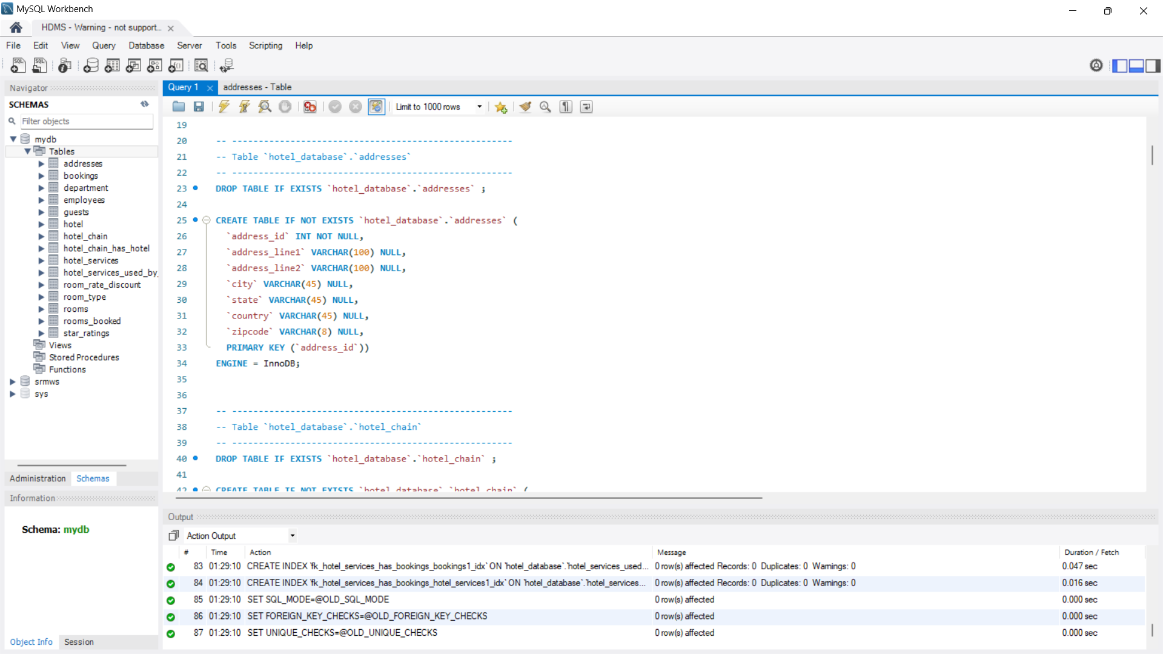
Create/Drop Command

Slide 14
Data Manipulation Language (DML)

Slide 15
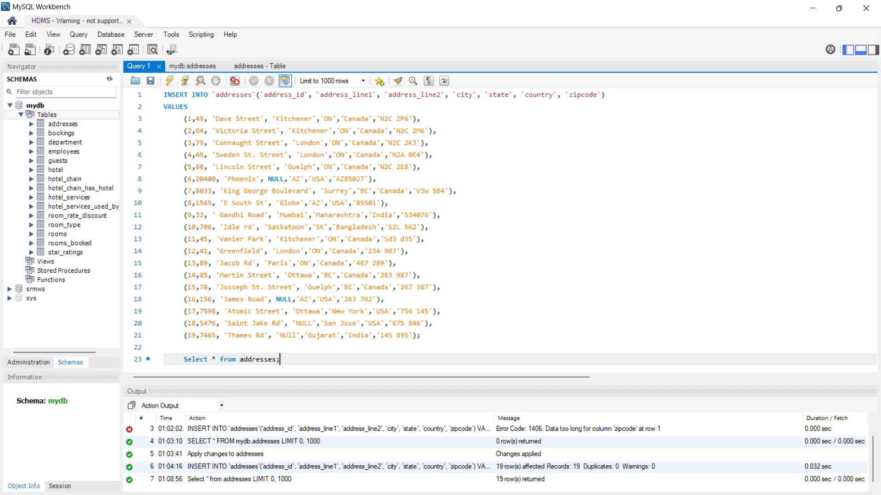
Insert Command

Slide 16
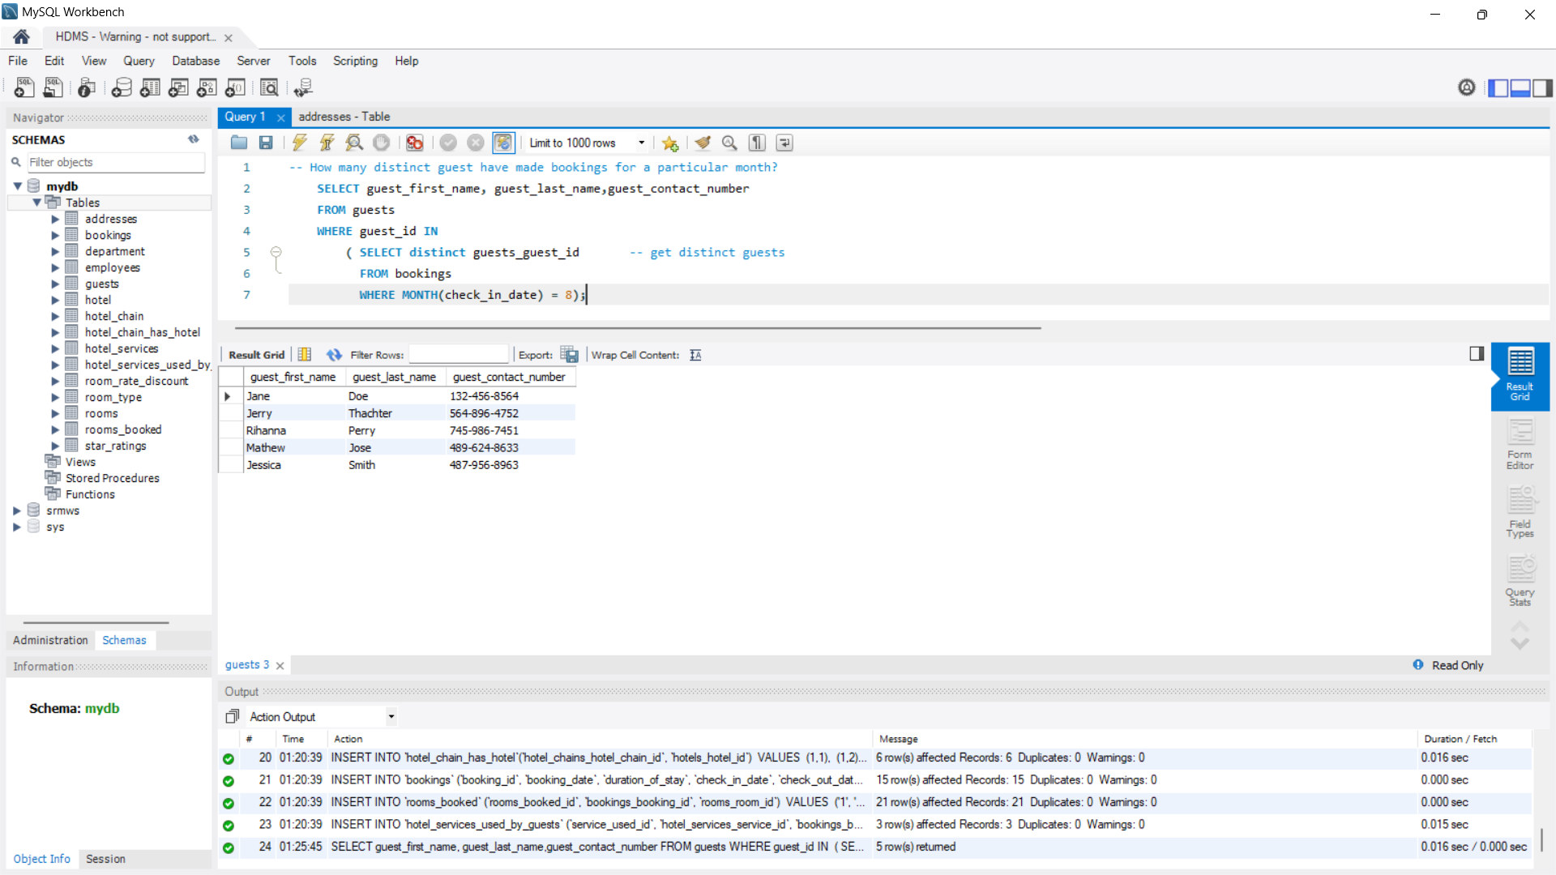
Select Command

Slide 17
Data Control Language (DCL)

Slide 18
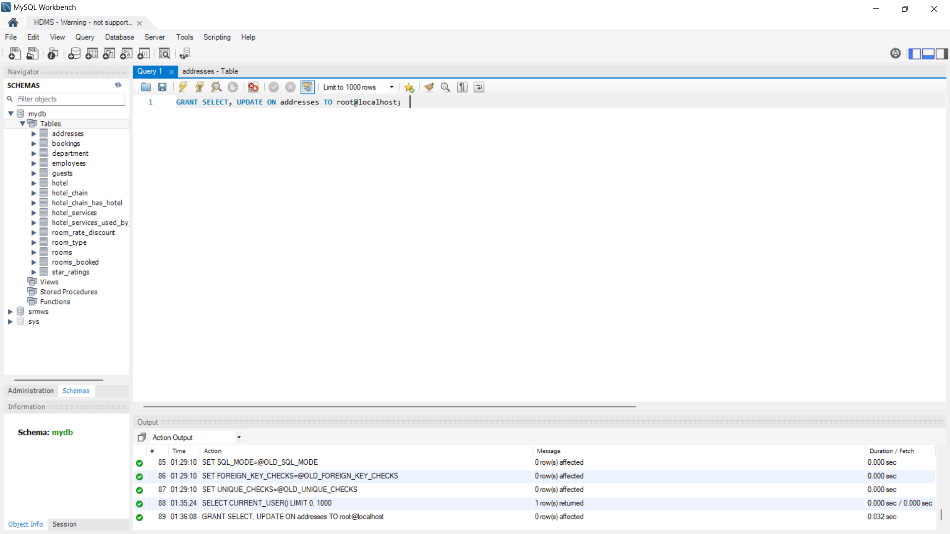
Grant Command

Slide 19
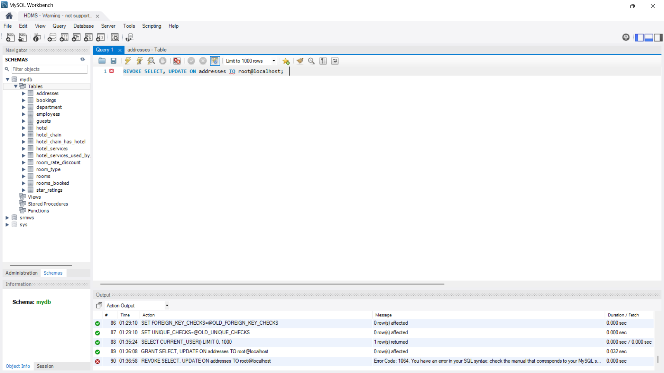
Revoke Command

Slide 20
Transaction Control Language (TCL)

Slide 21
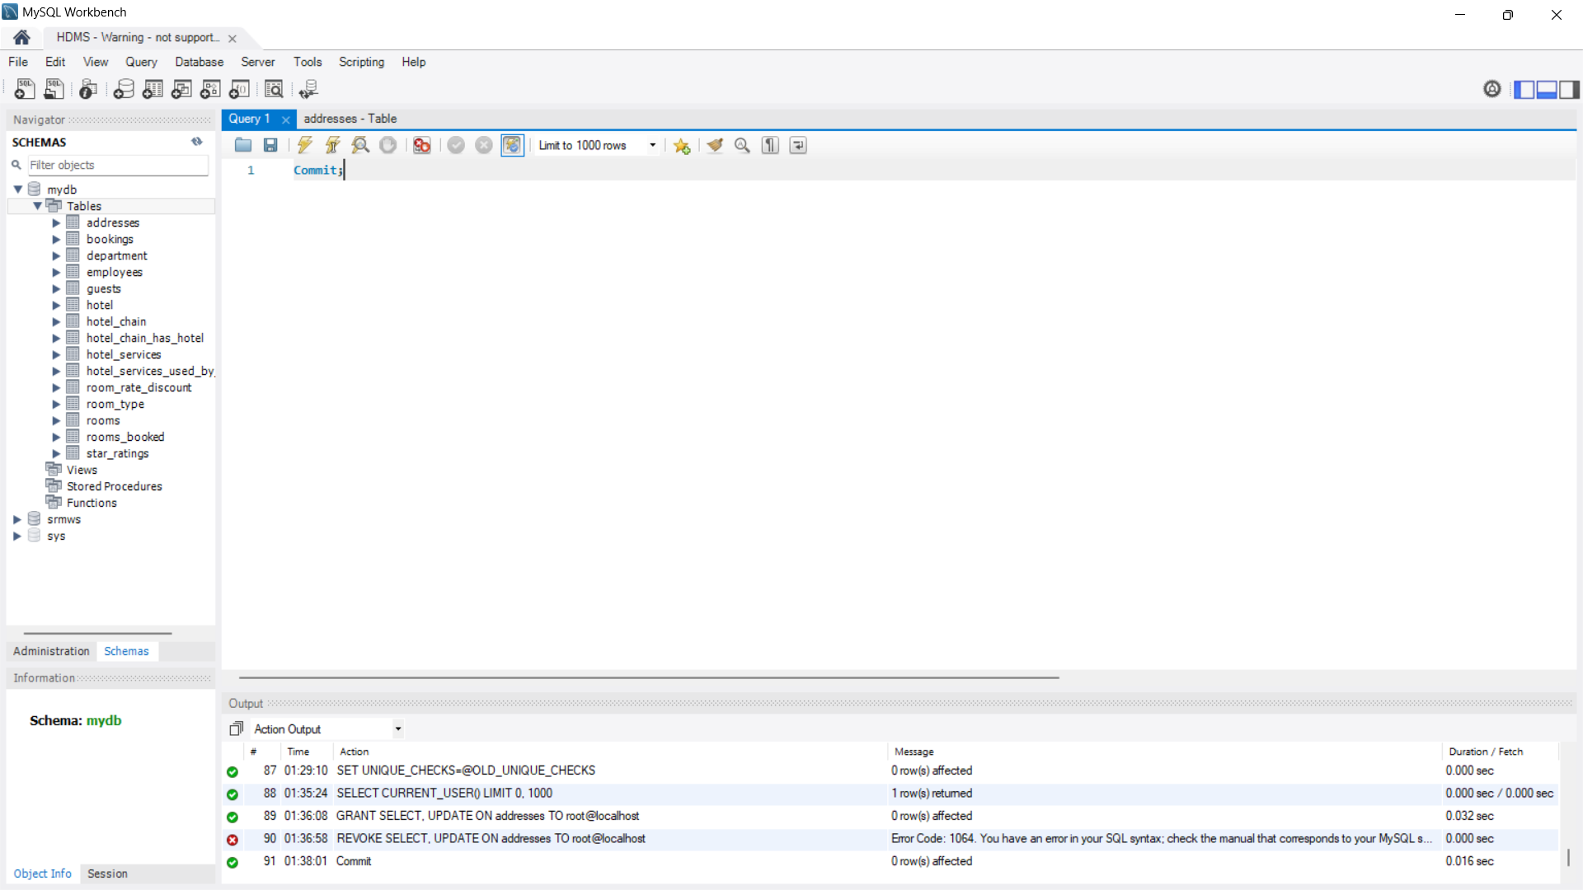
Commit Command

Slide 22
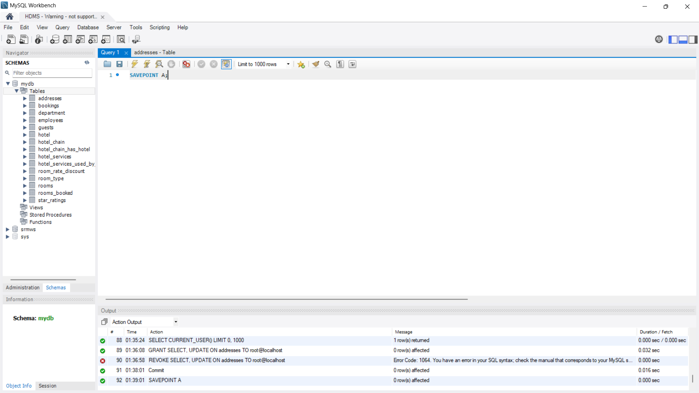
Savepoint Command

Slide 23
THANK YOU

